Slide 1

Big data platform (Spark) performance acceleration
Mentors: Tony Tan, Ning Wu, Yong Wang and Theo Gkountouvas
By:
Grishma Atul Thakkar
Virat Goradia
Nipun Midha
Baoshu Brady Qi

Slide 2
Recap
1. Spark's Shuffle Writer
2. Problem with original Shuffle writer
3. How riffle optimizes Spark's performance
4. Logical plan flow of the Spark
5. And we went in detail to see the flow of Spark's internal.
Notes:
We covered the spark's Shuffle writer
Discussed the problem with original Shuffle Writer
We discussed the how Riffle optimizes the performance by trading random reads for sequential reads.
We discussed the logical plan flow of the Spark
We debugged to show spark internal flow.

Slide 3

Sprint Goals
Design strategies to implement N-Way merge algorithm
Start implementing the N-Way merge algorithm.

Slide 4
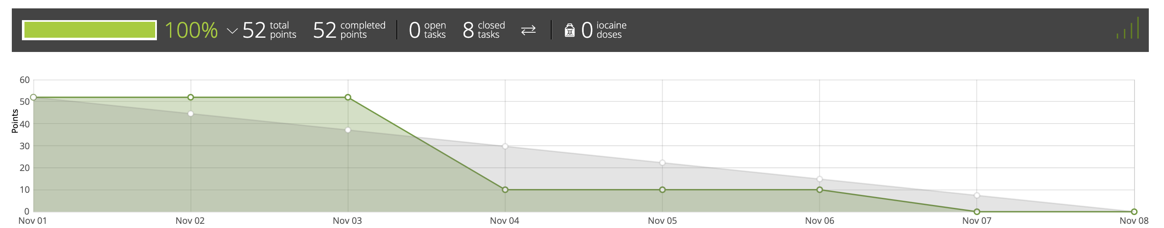
Burndown Chart

Slide 5



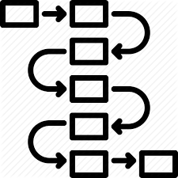
Challenges

Slide 6
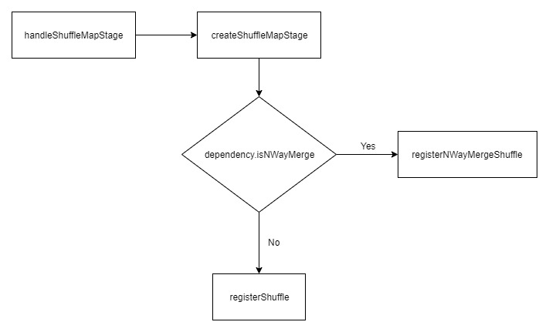
Our design (DAGScheduler)

Slide 7
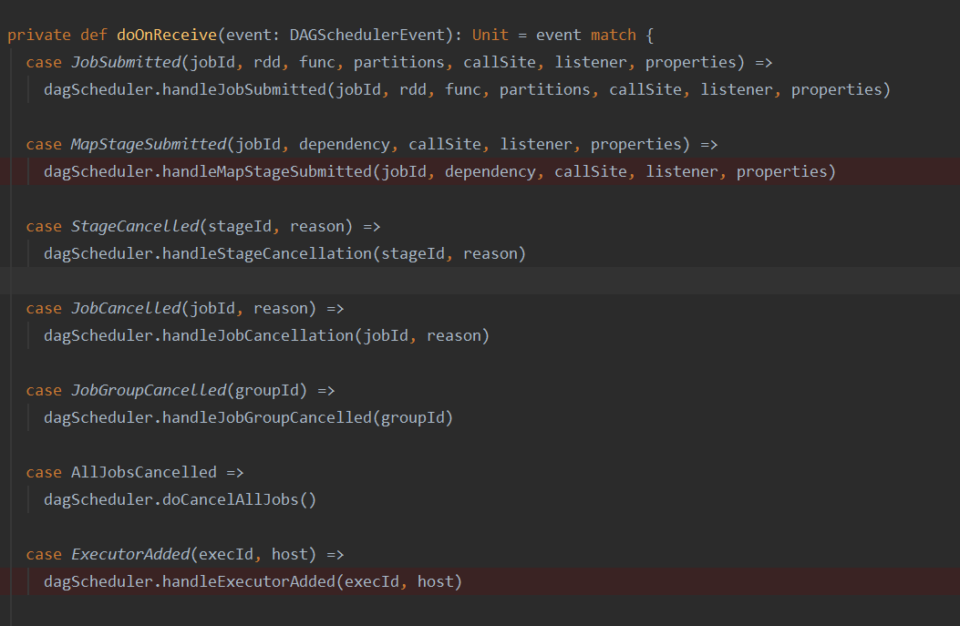
DAGScheduler event handler

Slide 8
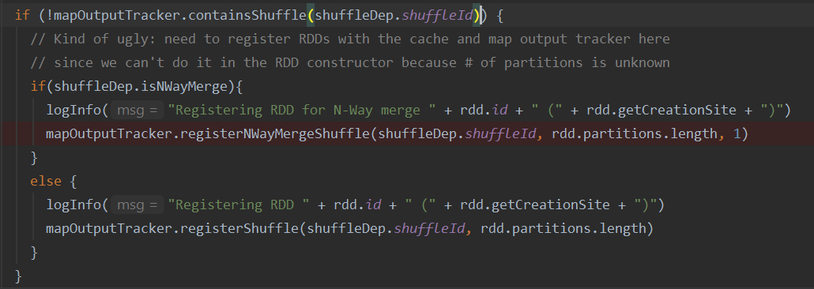
MapOutputTracker

Slide 9
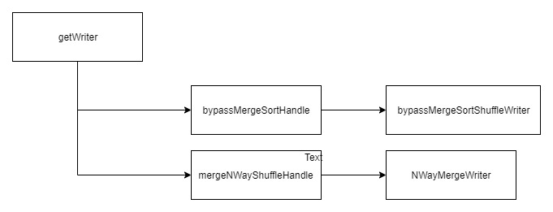
Our design (SortShuffleManager)

Slide 10
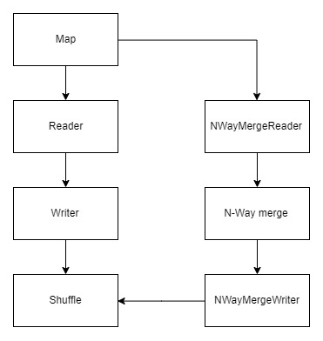
Our design (Achieved so far)

Slide 11
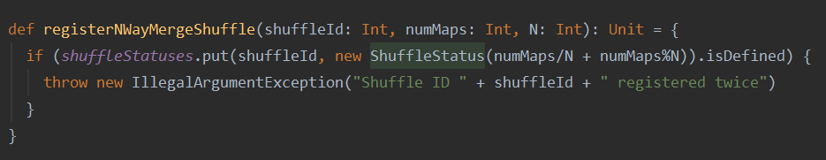
registerNWayMergeShuffle

Slide 12
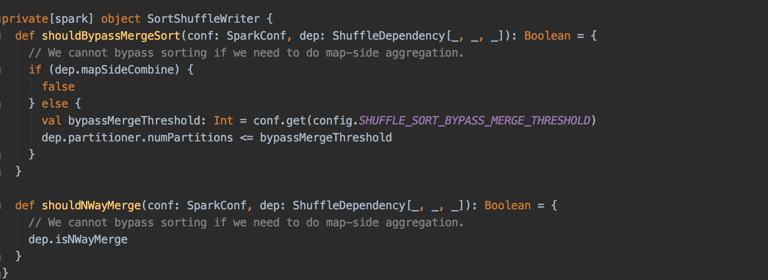
SortShuffleWriter

Slide 13
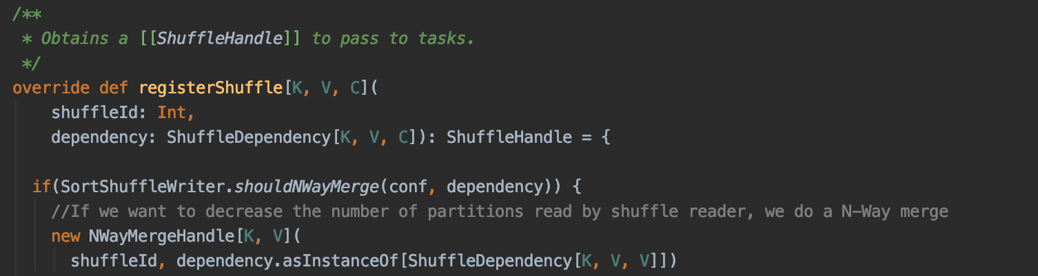
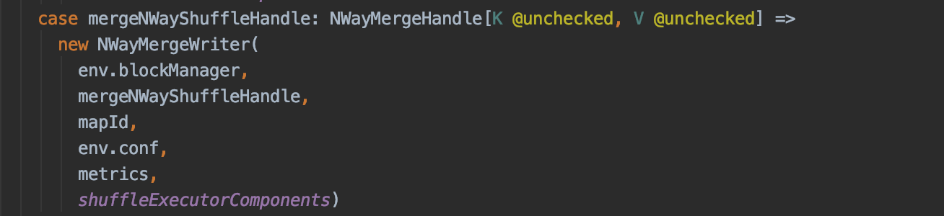
SortShuffleManager

Slide 14
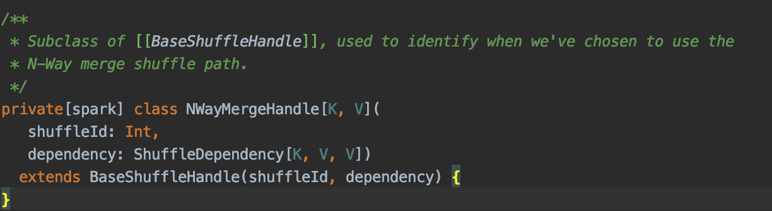
NWayMergeHandle

Slide 15
NWayMergeWriter
Created exclusively when SortShuffleManager selects a writer for a NwayMergeHandle
Write – Writing records into One Single Shuffle Block Data File
Write – Concatenating Per-Partition Files Into Single File (and Tracking Write Time)
Concrete ShuffleWriter that ShuffleMapTask uses to write records into one single shuffle block data file when the task runs for a ShuffleDependency

Slide 16
Why is this flawed?
Reducers will solely depend on the Merger output, final result would be incorrect if some merge tasks failed even if mapper tasks are all correct.
Our intentions:
1. Maintain the valid output of mapper.
2. Reduce the number of requests in shuffling phase by combining small files into larger ones.
3. Merge should be terminated almost immediately after all Mappers finish.

Slide 17
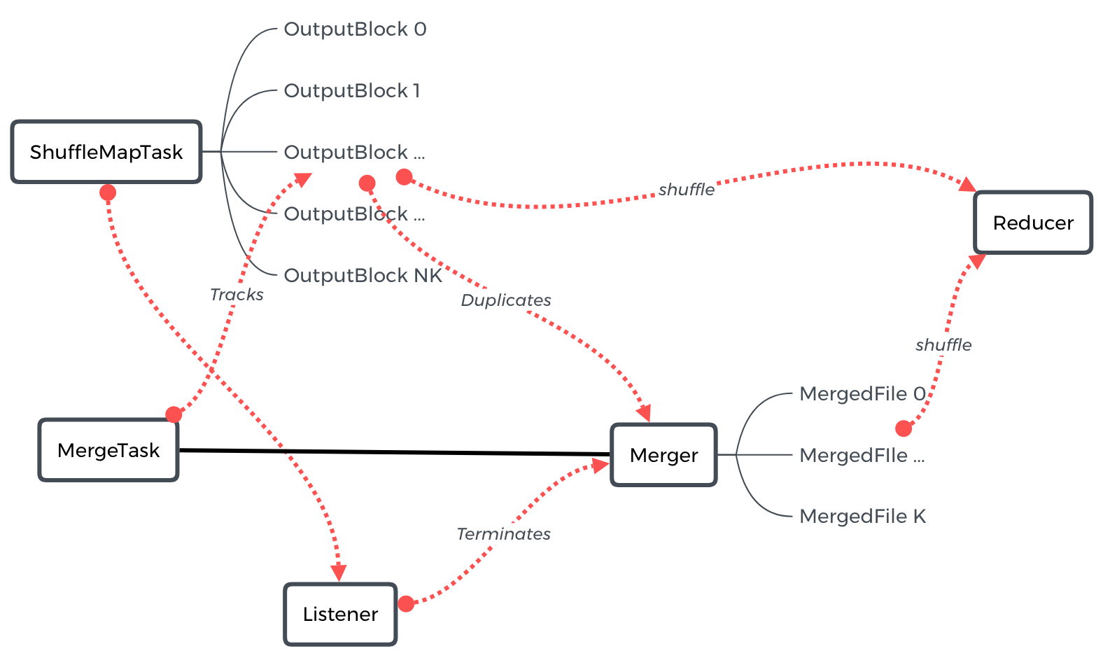
Solution
1. Map task and merge task start at the same time
2. Merge Task tracks the mapout put, whenever it meet the certain condition (e.g. N blocks), it starts to merge blocks together
3. Metadata of both merged files and origin files will be send to reducers and reducers will figure out if merged files are available

Slide 18
ShuffleBlockFetcherIterator
Old:
Address of Blocks: blocksByAddress: Iterator[(BlockManagerId, Seq[(BlockId, Long, Int)])]
Merge Continuous Blocks: mergeContinuousShuffleBlockIdsIfNeeded(curBlocks)
Number of fetch request depends on the number of discontinuous blocks
Our Implementation:
Merge blocks from different Mappers, reduce the number of fetch request more effeciently
Address of Blocks: mergedBlockByAddress: Iterator[(BlockManagerId, Seq[((BlockId, Long, Int), Seq[(BlockId, Long, Int)])], Seq[(BlockId, Long, Int)])],
Check Validation: Size check

Slide 19
Next Sprint Goals
Change our implementation and use observer pattern

Slide 20

Thank You!
Any Questions?

